Slide 1
Analysis Week 6

Slide 2
Kinds of Analysis
* How does all the work we have done so far enable us to ask new questions of our materials?
* How do quantitative and qualitative analyses relate to one another?
* Introduction: Qualitative vs Quantitative Analysis
* Activity: Workshop on Looker Studio

Slide 3
Looker Studio
Data analysis is a HUGE area – we are going to just scratch the surface
Often requires programming
Limited here by
Experience
Technical skill
Cost of tools

Slide 4


Slide 5
Plan
Upload our data to google sheets
Make a looker studio project
Embed a table
Make a line graph
Make a scatterplot

Slide 6
Upload our Data to Google Sheets
Will require a gmail account
Doesn’t have to be your real one
One of the tradeoffs here – this is free because google wants your data
Go to sheets.new in a browser.
File -> import -> upload from your computer
Upload the audible dataset.
Should now be part of your google drive account

Slide 7
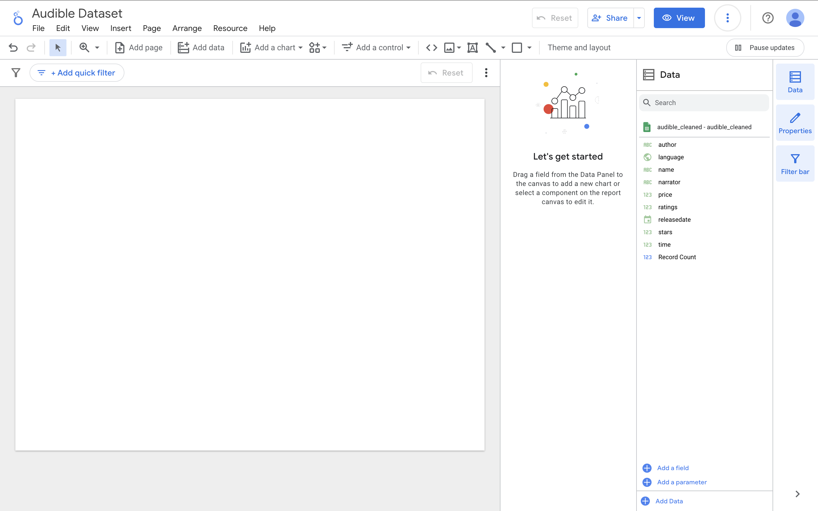
Make a New Project and Add Our Data
https://lookerstudio.google.com/
Click new blank project
Will ask you to give a location and company
But then at the end of the day should bring you here
Click “add data”
Click google sheets
You should be able to find the audible dataset if it’s on your google drive
Now we have our audible data in the report

Slide 8
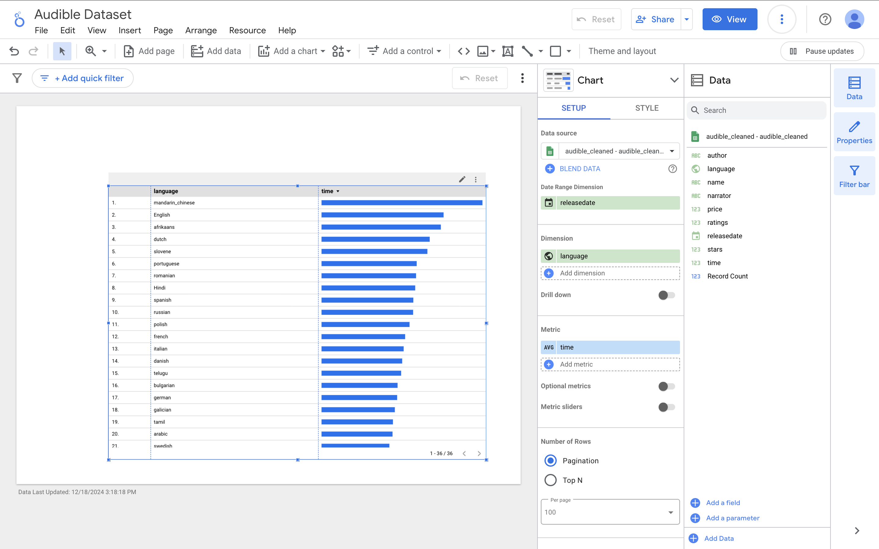
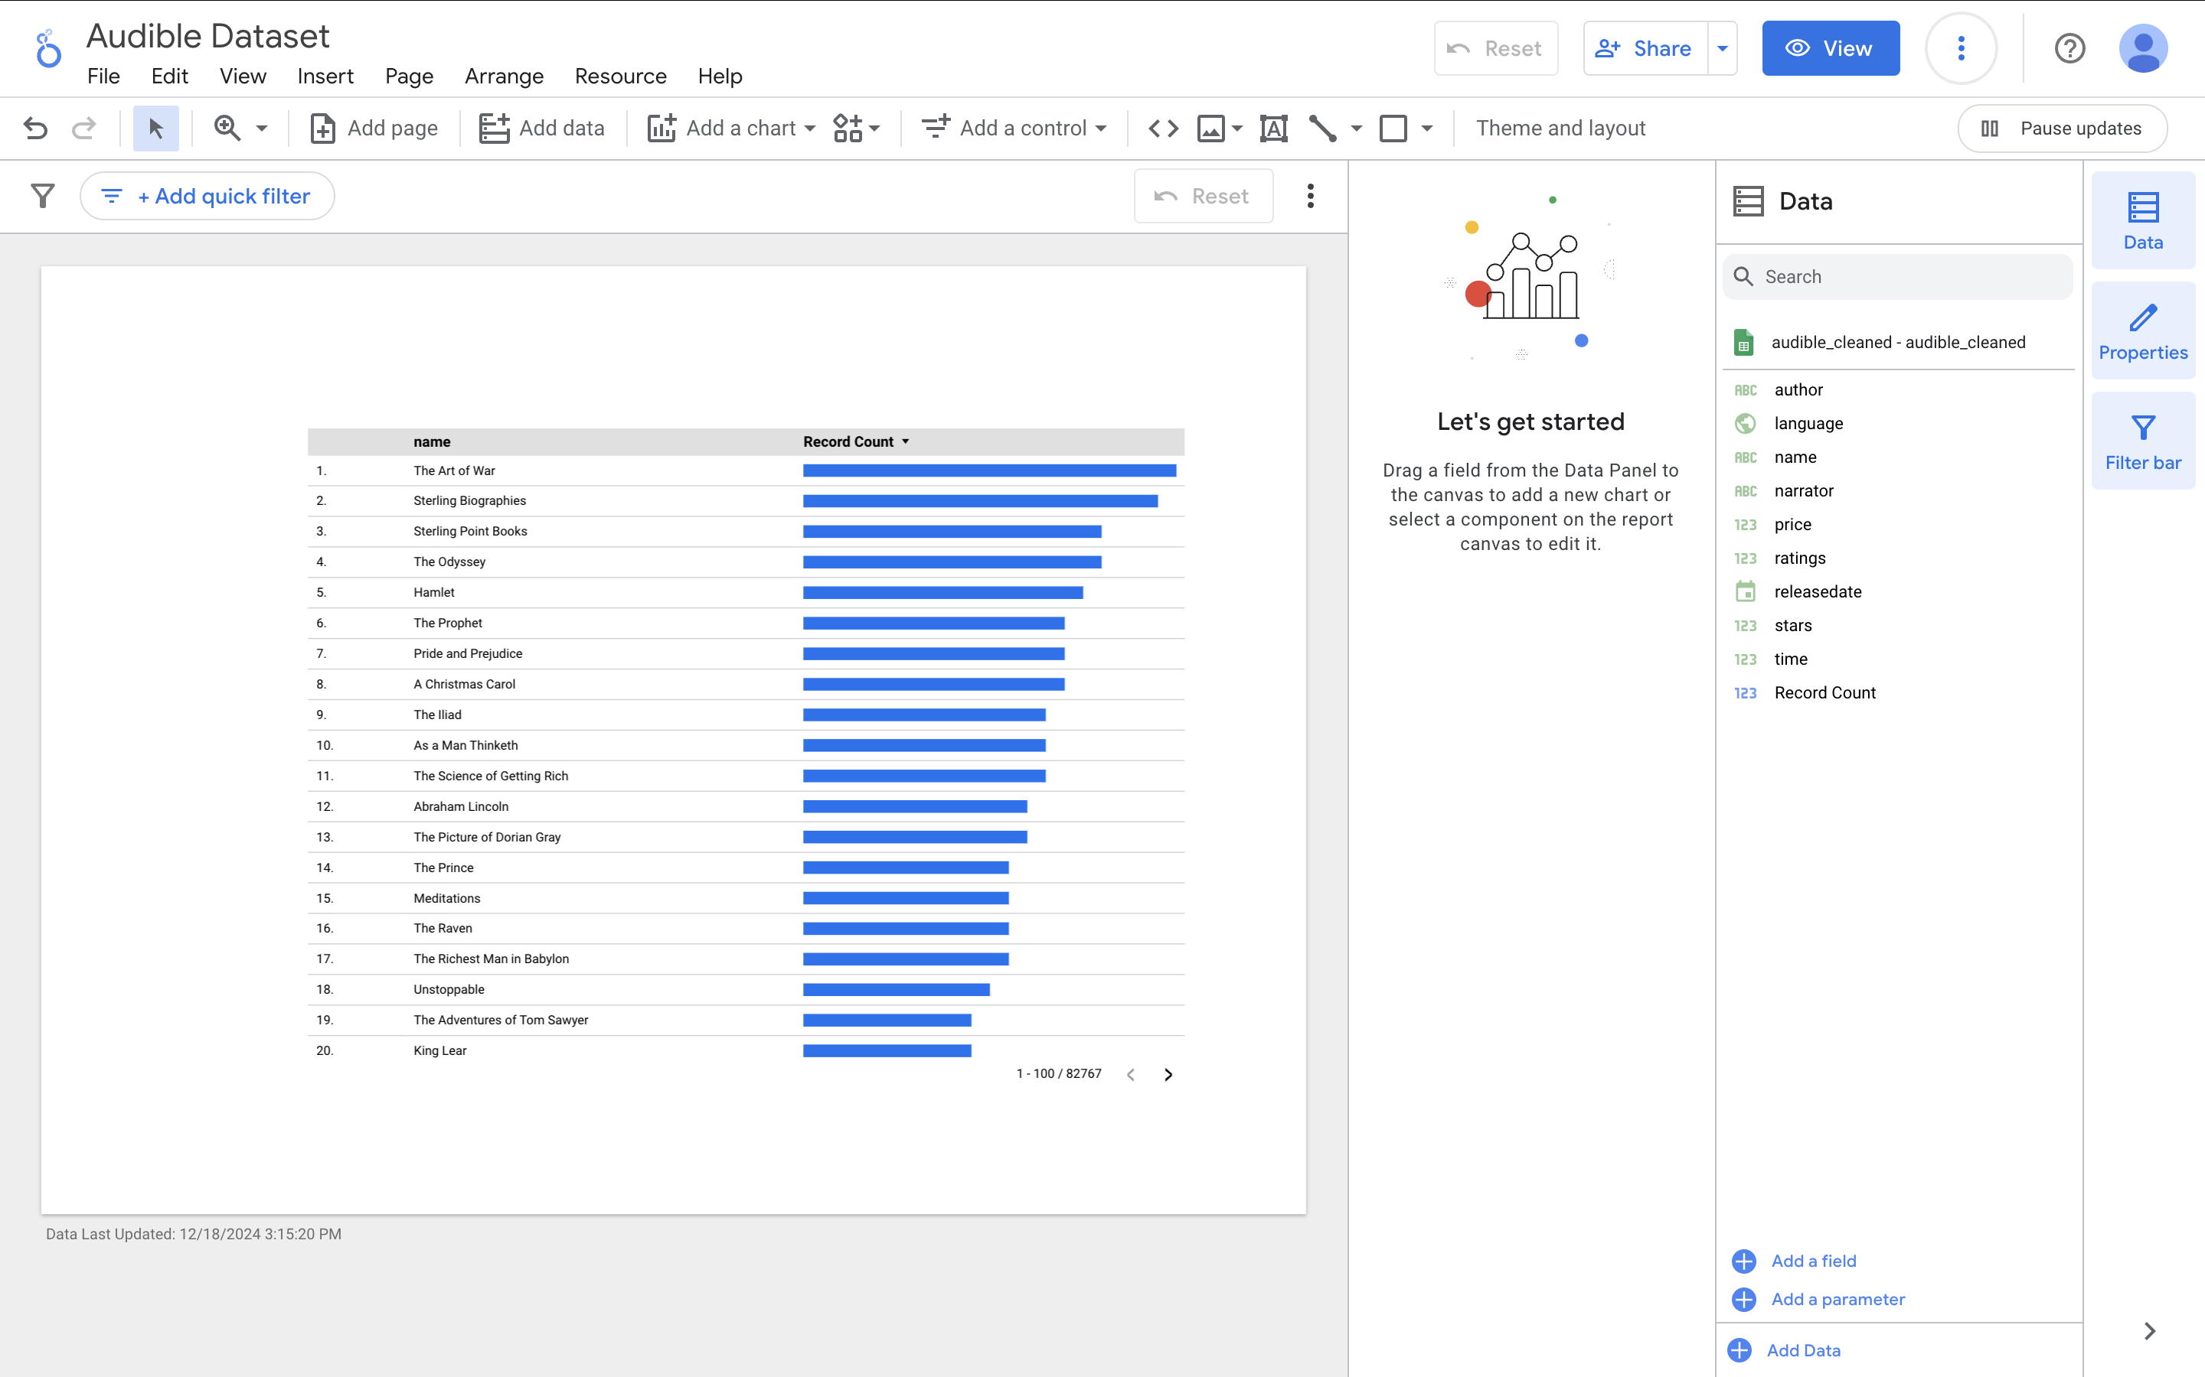
Adding a Table
Click “add a chart”
Select “Table with Bars”
Note the dimensions and axes – we can change them.
By default we got a chart of most common books. But we can change that! Let’s modify settings from top to bottom.
Pay attention not just to the metrics but also to whether they are raw counts/sums/avg
Result is that we have a graph for how long, on average, the typical audiobooks are for each language

Slide 9
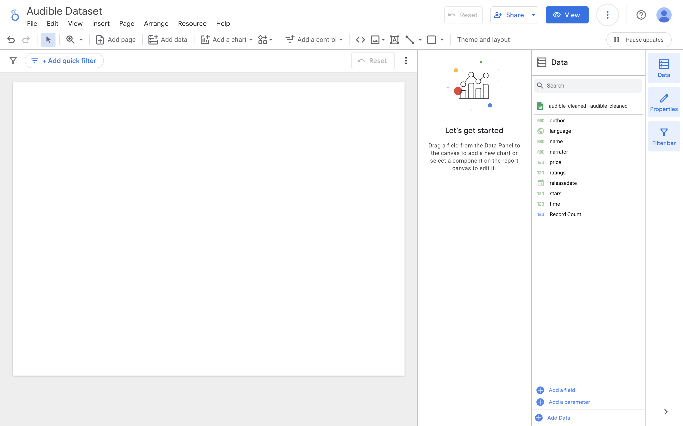
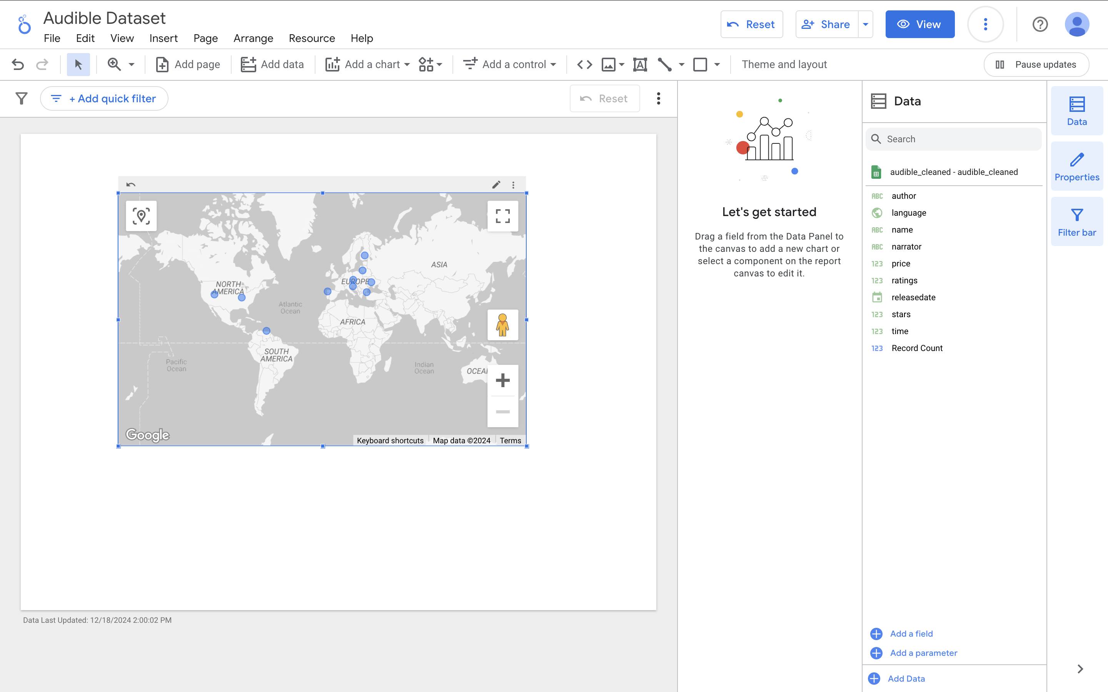
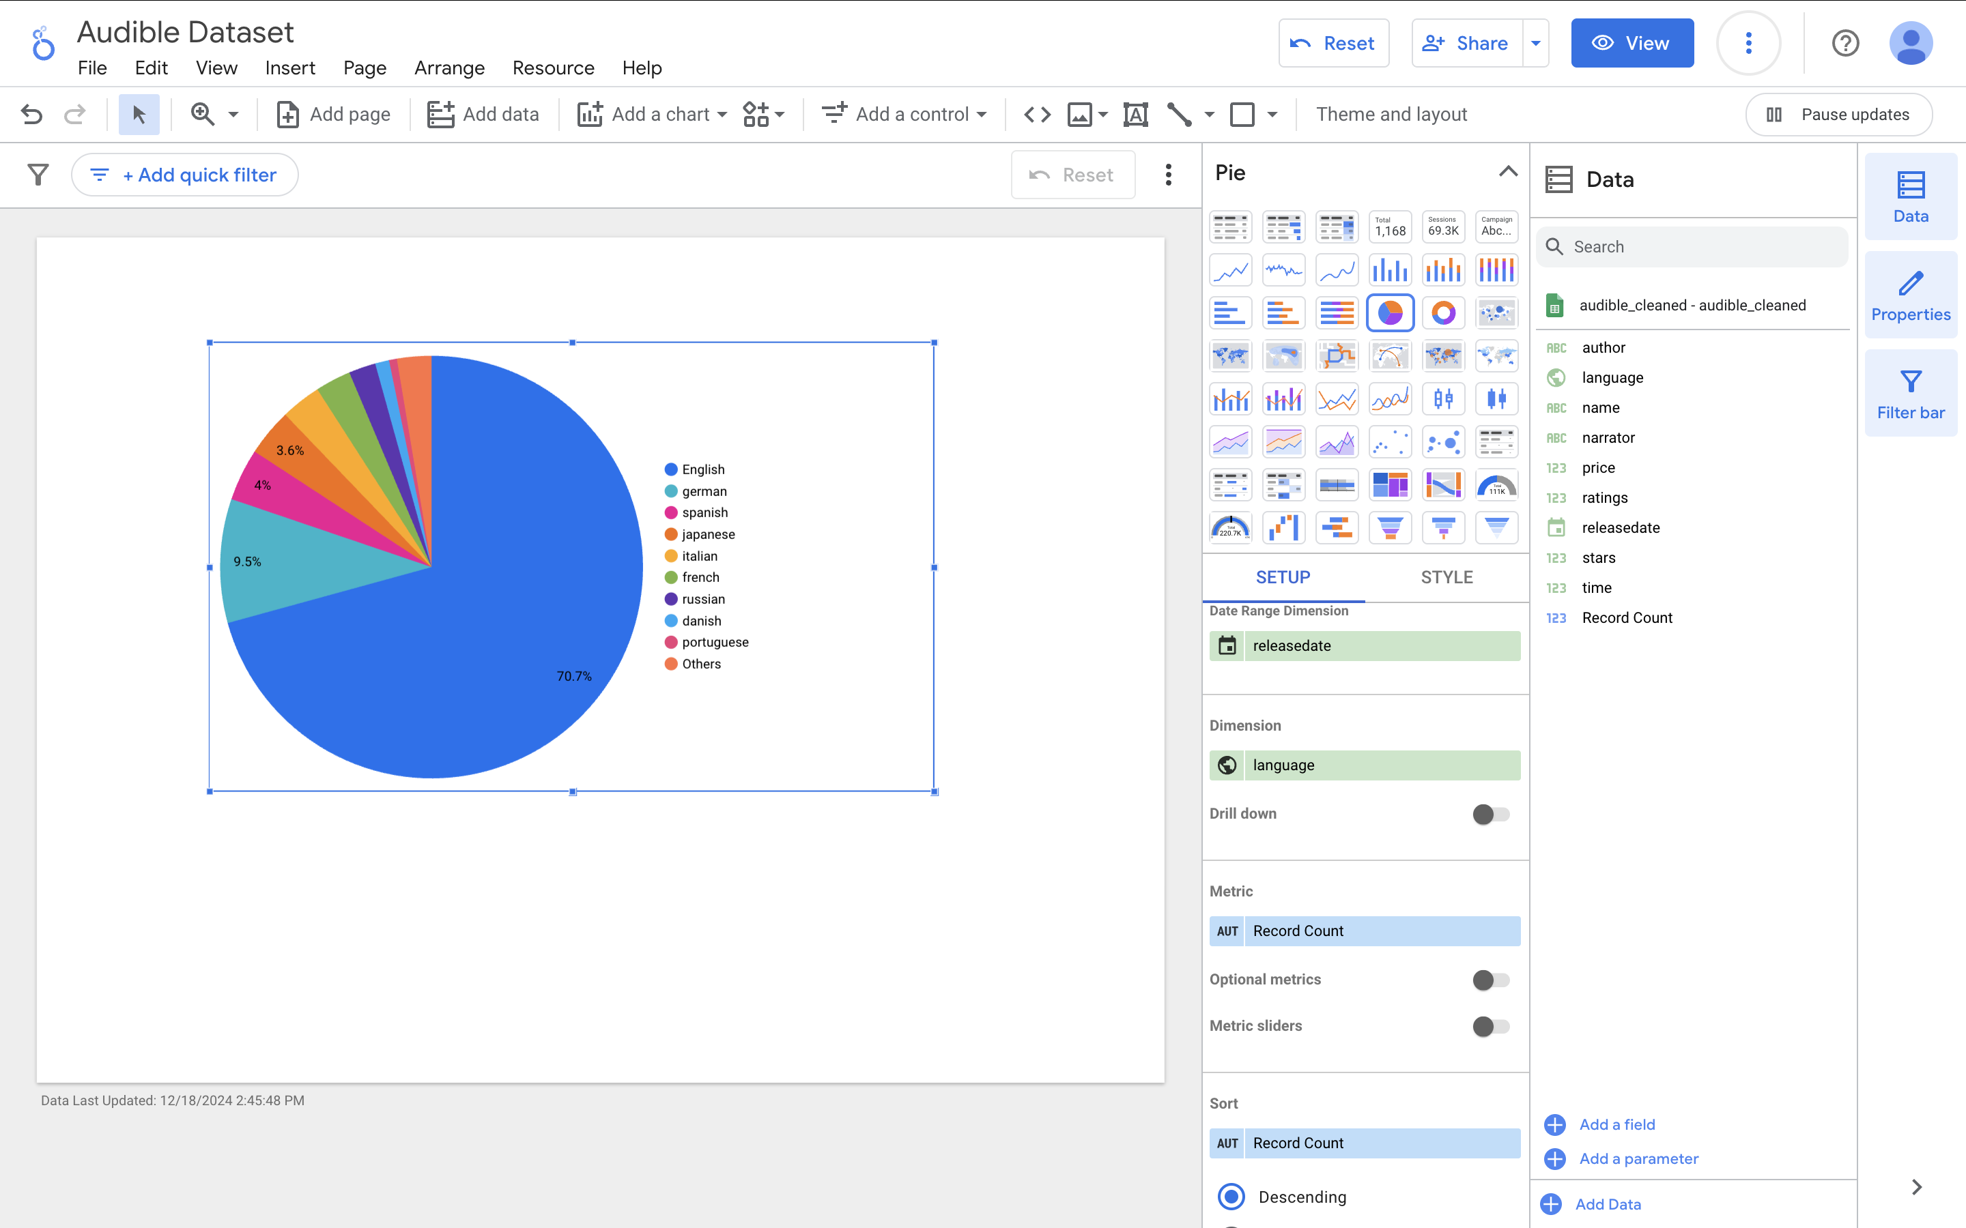
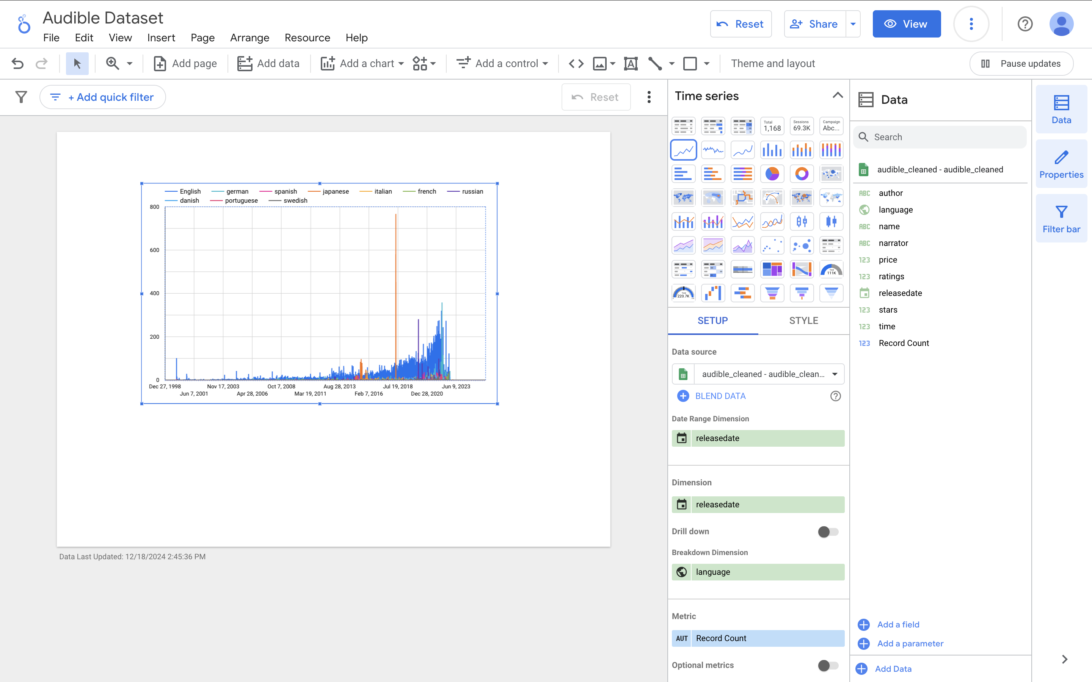
Language Graphing
Drag a data field over. Let’s grab “language”
Expand the chart and click it
Change it to a pie chart
Then again to a time series
Google will infer a lot!

Slide 10
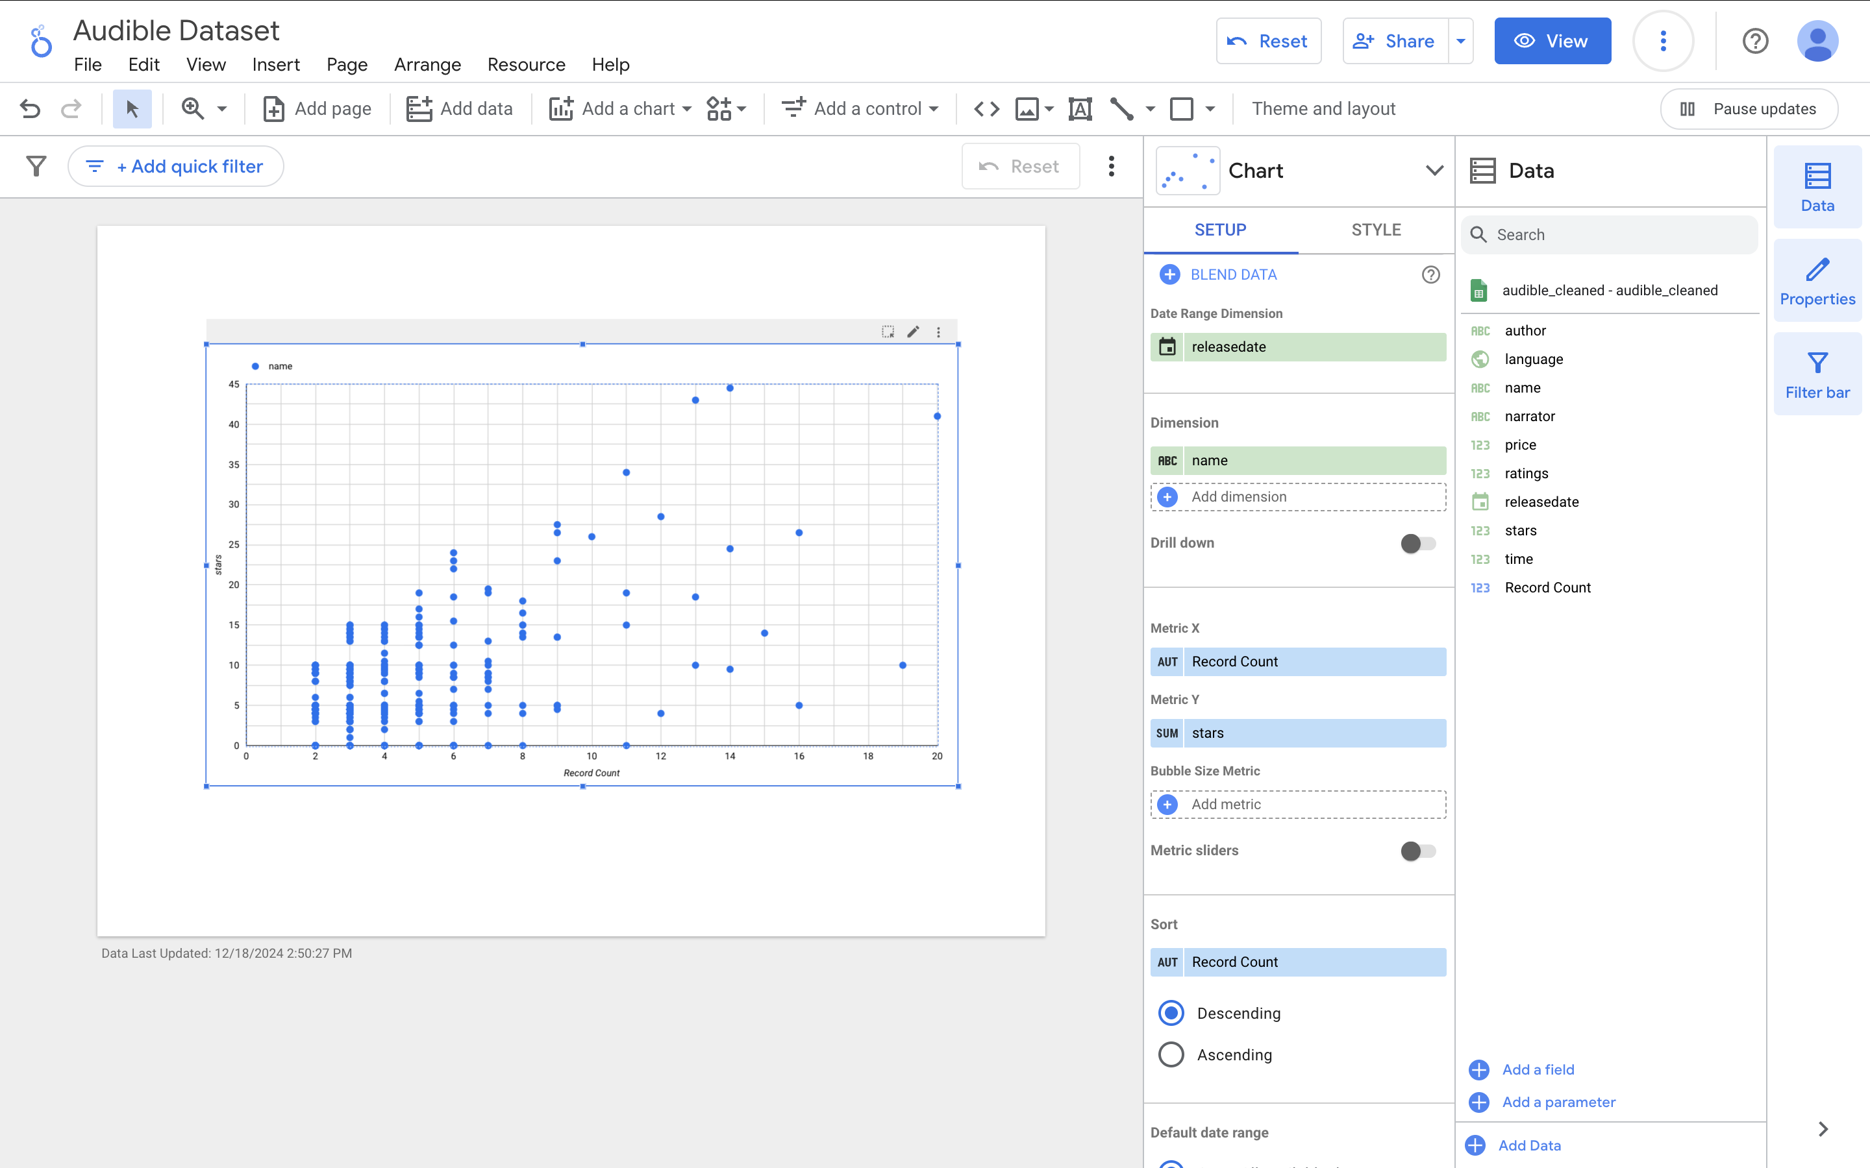
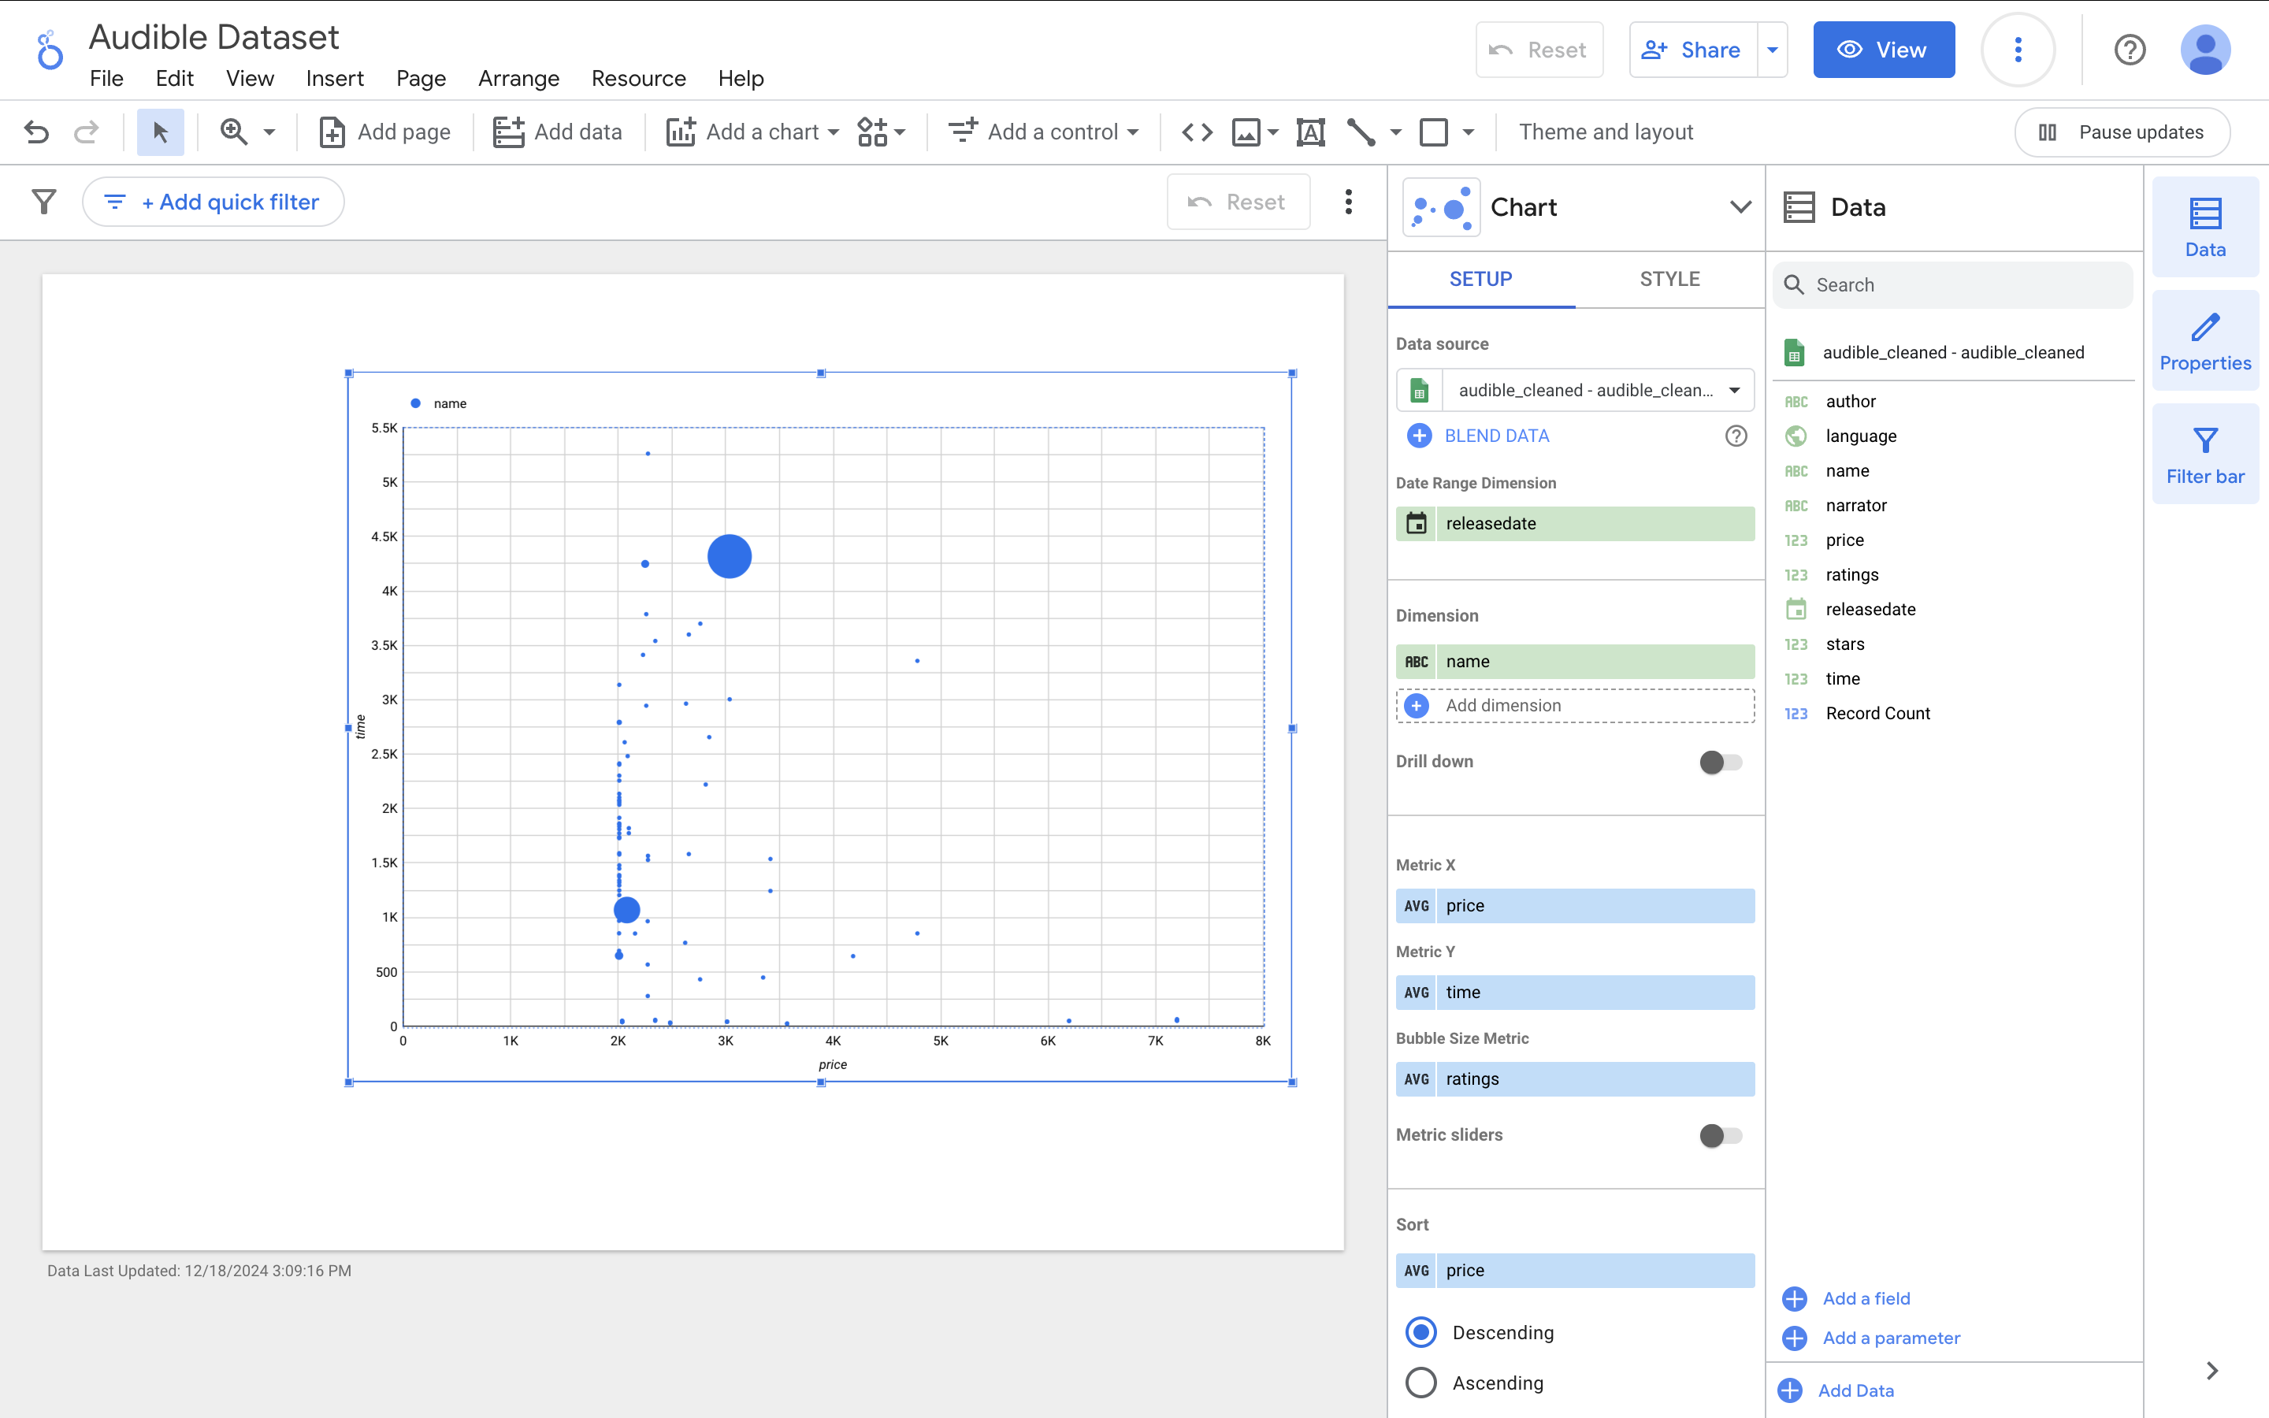
Adding a Scatterplot
Click “add a chart”
Scroll and select “scatter”
Note the dimensions and axes – we can change them.
I changed the default to the bottom
Pay attention not just to the metrics but also to whether they are raw counts/sums/avg
Try playing around by changing these values and also the style menu

Slide 11
Work Time
Play with the tool and see what you can do!
I’ll float to help

